Slide 1
Google Sketchup
3 views of created home
By: Amanda Lohr

Slide 2
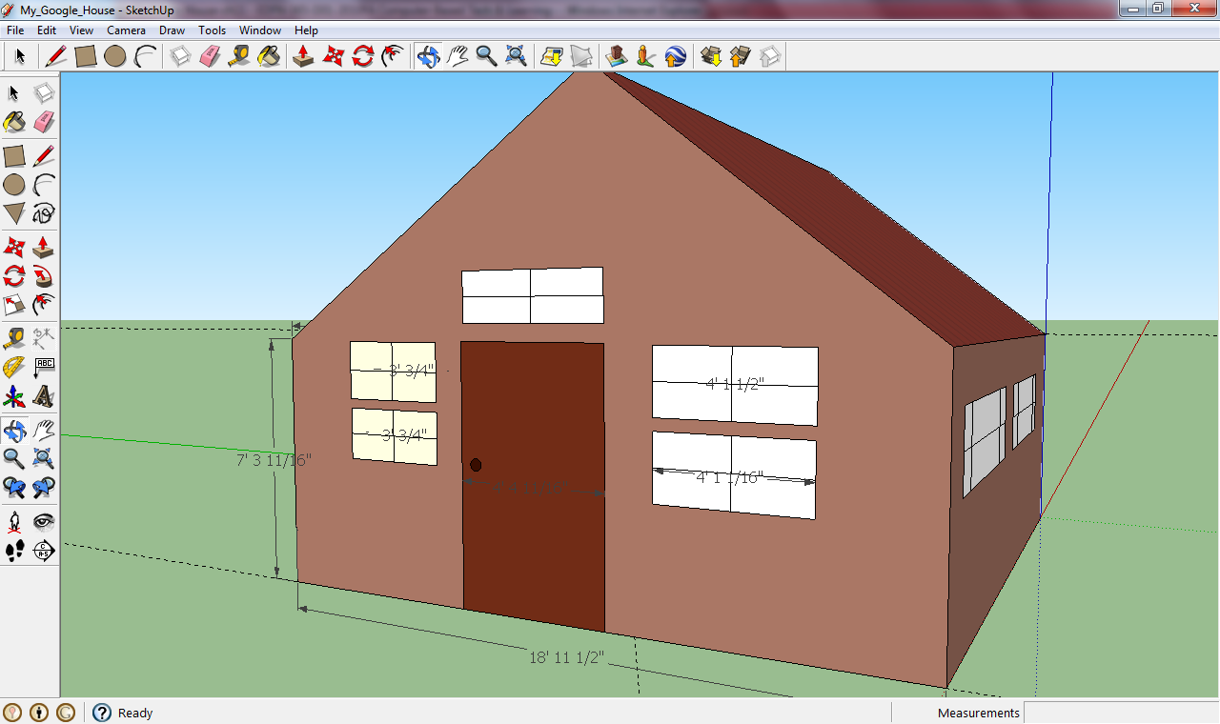
View 1

Slide 3
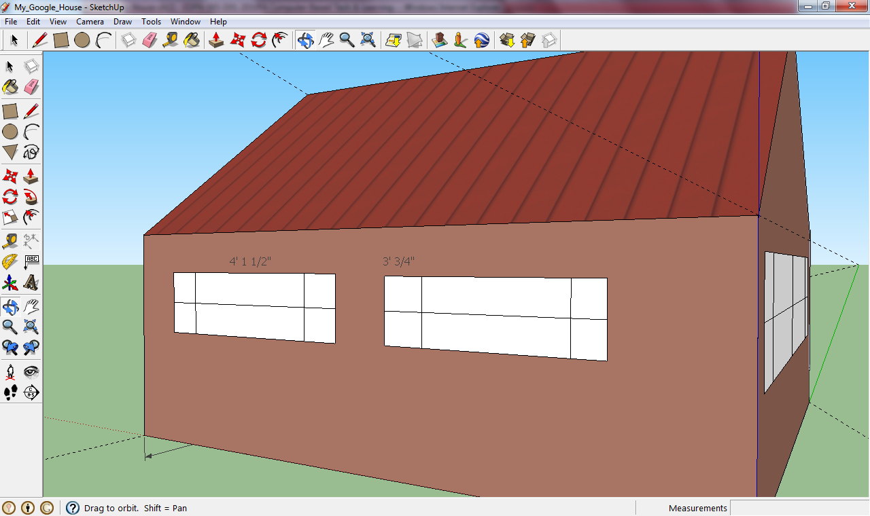
View 2

Slide 4
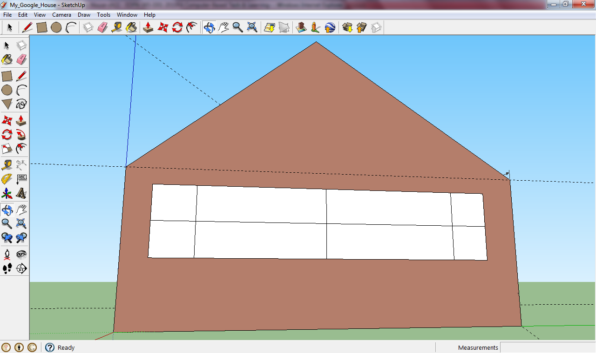
View 3

